Slide 1
Renaissance Humanism: Erasmus
Dr. Stephanie Spoto
5/9/2019
Monterey Peninsula College
Gentrain 407: The Early Renaissance

Slide 2
Humanism
Study of classical antiquity
A shift in focus from exclusive study of religion towards the study of humankind
Returning interest in the pagan classics stimulated three major shifts in European philosophy:
the philosophy of secularism
the appreciation of worldly pleasures
Assertion of personal independence and individual expression
Crossroads between medieval supernaturalism and modern skeptical and scientific paradigms

Slide 3
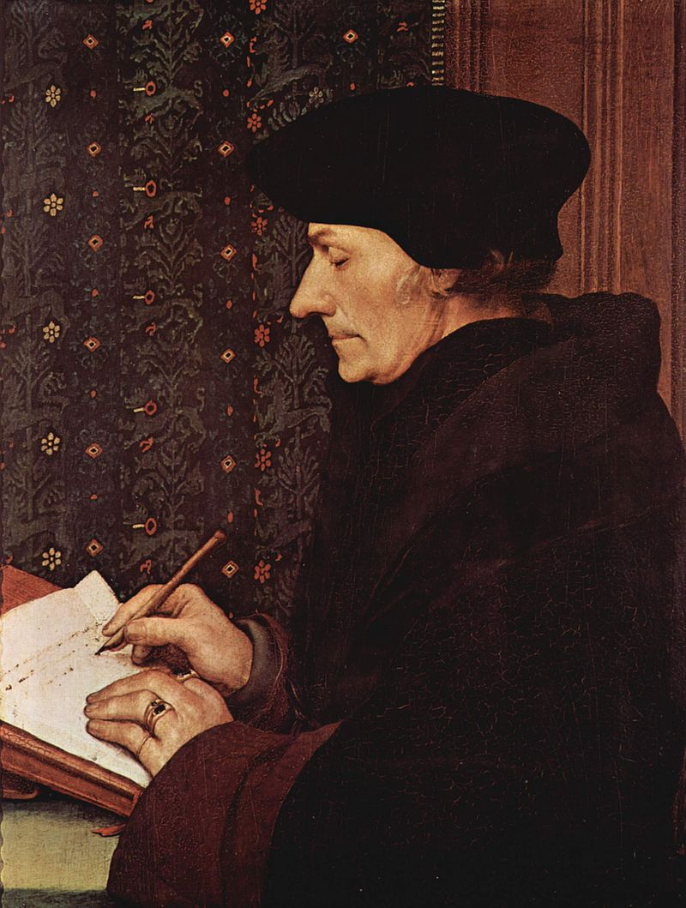
Erasmus, Prince of the Humanists 1466-1536
Desiderius Erasmus Roterodamus (Erasmus or Erasmus of Rotterdam)
Dutch Christian humanist
Tracey James calls him the greatest scholar of the northern Renaissance.
Christian priest → Prince of the Humanists and the crowing glory of the Christian humanists.
Wrote in the pure Latin style → part of the revival of Ciceronian Latin

Slide 4
Translations and contributions
Created new and important Latin and Greek editions of the New Testament → used humanist techniques for working on the text
These translations raised important questions that would be influential in the Protestant Reformation and then later the Catholic Counter-Reformation
Author of number of works, including:
Handbook of a Christian Knight, 1503/1533
In Praise of Folly, 1509
Copia: Foundations of the Abundant Style, 1512
Julius Exclusus, 1514
On Free Will, 1524
On Civility in Children, 1530

Slide 5
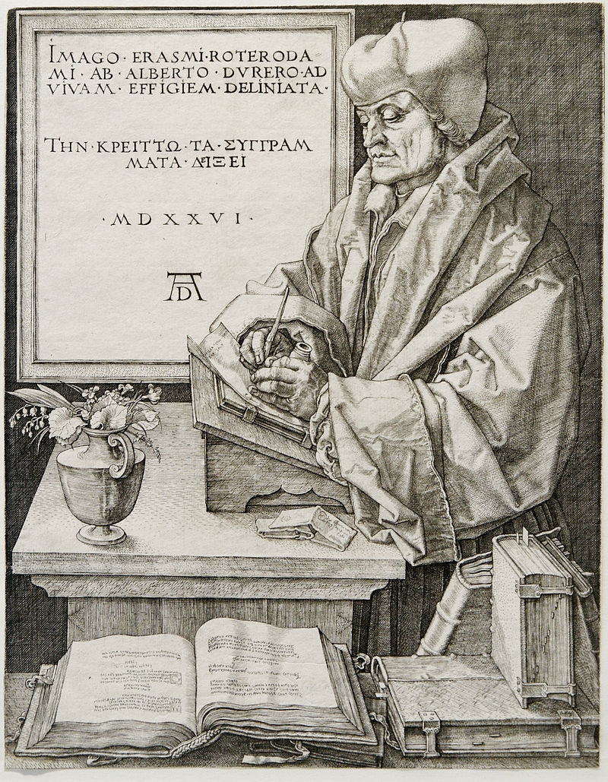
Erasmus as philosopher
Not a systematic philosopher → though there are themes that he is interested in and what we might call an “Erasmian habit of mind”.
The subjects of his writing were often philosophical or invited philosophical reflection, such as:
Nature versus nurture
The relationship between word and thing
Nature of faith
What is the ideal form of government?
Epistemology: theory of knowledge
Works widely circulated and read → views are interesting to historians today → opinion maker
Portrait of Desiderius Erasmus by Albrecht Dürer, 1526, engraved in Nuremberg, Germany.

Slide 6
Erasmus and the Church
Lived during the development of the Reformation
Critical of abuses in the church → called for reform
Distanced himself from reformers of what would be later called the Protestant Reformation, like Martin Luther, Henry VIII and John Calvin → continued to recognize the authority of the Pope. Remained member of Catholic Church his whole life
Importance of “middle way” (via media)
Respect of piety, grace and tradition faith → rejected Luther’s “faith alone.”
Adhered to Catholic doctrine of “free will” against the reformers doctrine of predestination

Slide 7
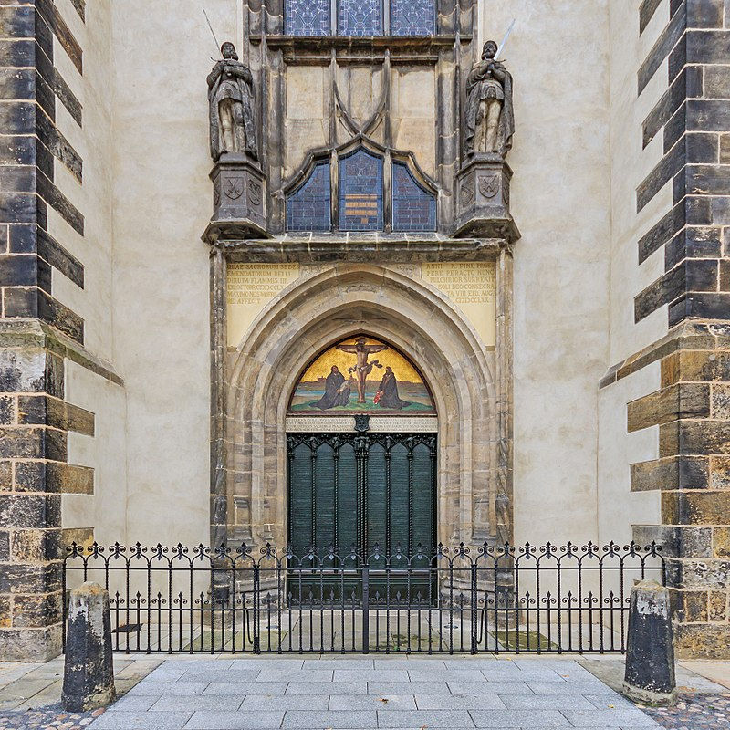
Impartiality
Erasmus attempted to be impartial during philosophical, political, and theological disputes
His “middle way” approach angered both Catholics and reformers (Luther famously nailed his 95 theses to the door of the Wittenberg Castle Church)
Was critical of the Catholic church and was called to join reformers → was loyal to the church and wanted to reform it from within

Slide 8
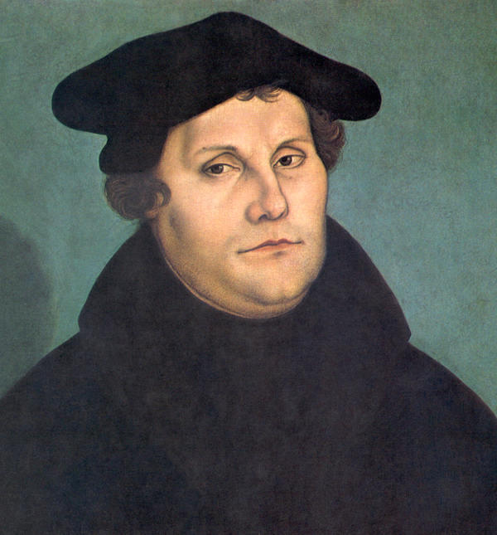
Luther and Erasmus
Luther in 1526 letter to Erasmus: "Free will does not exist“ → sin makes human beings utterly incapable of submitting themselves to God.
Respected each other
Eramus called Luther "a mighty trumpet of gospel truth“
Erasmus: "It is clear that many of the reforms for which Luther calls are urgently needed.“
Luther’s reformation seemed the natural development from Erasmus’s writings
Luther wanted to remain independent
Martin Luther (1529) by Lucas Cranach the Elder

Slide 9
“An epistle against those who falsely boast they are Evangelicals” to Vulturius Neocomus (Gerardus Geldenhouwer), 1529
You declaim bitterly against the luxury of priests, the ambition of bishops, the tyranny of the Roman Pontiff, and the babbling of the sophists; against our prayers, fasts, and Masses; and you are not content to retrench the abuses that may be in these things, but must needs abolish them entirely...
Look around on this ‘Evangelical’ generation, and observe whether amongst them less indulgence is given to luxury, lust, or avarice, than amongst those whom you so detest. Show me any one person who by that Gospel has been reclaimed from drunkenness to sobriety, from fury and passion to meekness, from avarice to liberality, from reviling to well-speaking, from wantonness to modesty. I will show you a great many who have become worse through following it....The solemn prayers of the Church are abolished, but now there are very many who never pray at all....

Slide 10
“An epistle against those who falsely boast they are Evangelicals” to Vulturius Neocomus (Gerardus Geldenhouwer), 1529
I have never entered their conventicles, but I have sometimes seen them returning from their sermons, the countenances of all of them displaying rage, and wonderful ferocity, as though they were animated by the evil spirit....
Who ever beheld in their meetings any one of them shedding tears, smiting his breast, or grieving for his sins ?... Confession to the priest is abolished, but very few now confess to God.... They have fled from Judaism that they may become Epicureans.

Slide 11
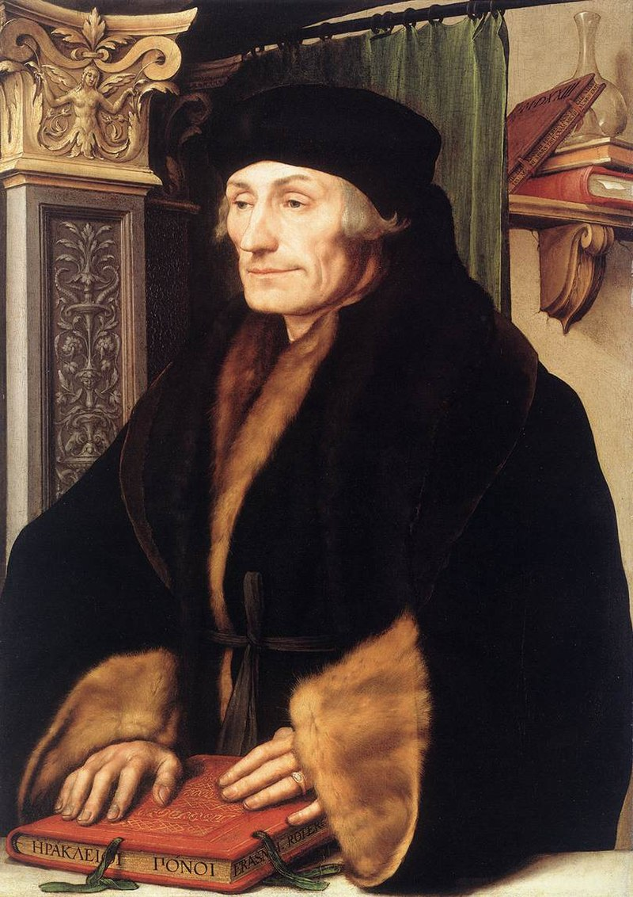
Free Will
In 1524 On Free Will, enters into the field of doctrinal controversy
Rejects Luther’s doctrine of free will
Doesn’t suggest action
For Erasmians this was a merit → for Lutherans this was a fault
Claims more free will than Luther allowed to St Augustine and St Paul → freedom of choice is central of Erasmus
Protestantism garnered popular movement → Erasmus distanced himself from it and moved when his city of Basel adopted Reformation in 1529
Portrait of Erasmus of Rotterdam (1523) by Hans Holbein the Younger

Slide 12
Religious toleration
Some works (like De libero arbitrio 1514) argued for religious toleration
Urged Lutherans to be more temperate in their language"because in this way the truth, which is often lost amidst too much wrangling may be more surely perceived.“
Gary Remer (Humanism and the Rhetoric of Toleration 1996): "Like Cicero, Erasmus concludes that truth is furthered by a more harmonious relationship between interlocutors.”
Did not oppose the punishment of heretics in general → however in individual cases he argued for moderation: "It is better to cure a sick man than to kill him."
Place of publication | Basileae
Printer/publisher | Apvd Ioannem Beb.
Year (month) | (1524)

